Slide 1


Movie Application
Ahmad Zulikmal

Slide 2
Purpose
Personalized movie recommendations to users based on their viewing history and preferences.
A recommendation algorithm that utilizes machine learning to improve its accuracy and relevance.
A user-friendly interface for browsing and selecting recommended movies.
Integration with a database of movies and user data for recommendation generation and storage.

Slide 3
Intended Audience and Reading Suggestions
Developers :
Project Managers
Users
Testers

Slide 4
Project Scope
The software being specified is a movie recommendation system. Its purpose is to provide personalized movie recommendations to users based on their viewing history and preferences. The benefits of this system include improved user engagement and satisfaction, as well as increased revenue from targeted movie recommendations. The main objectives and goals of the system are to provide accurate and relevant movie recommendations, as well as to continuously improve the recommendation algorithm through machine learning. The system aligns with corporate goals and business strategies by leveraging data and technology to enhance the user experience and drive revenue growth. A separate vision and scope document should provide more details on the long-term strategic product vision for the movie recommendation system.

Slide 5
User Classes and Characteristics
Casual Users
Regular Users
Power Users

Slide 6
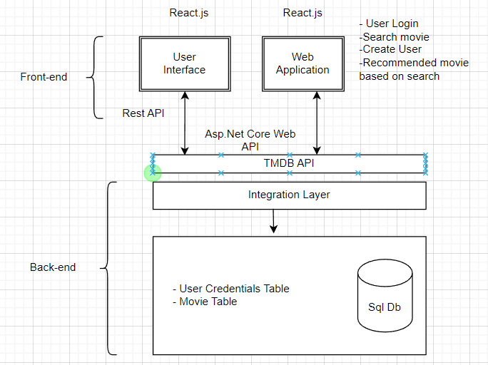
High level diagram

Slide 7
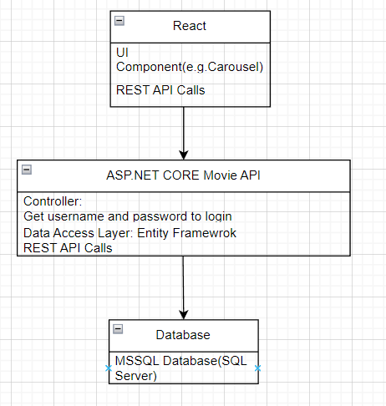
Low-level diagram

Slide 8
Movie Recommender System Functional Requirements
User Management
Movie Database
Reporting Analytics
Security and Privacy

Slide 9
Nonfunctional Requirements
Response time: The system should have a fast response time, with page loading time not exceeding 2 seconds on a fast network connection. This is important to ensure a good user experience.
API response time: The time taken to retrieve movie data from external APIs should not exceed 2 seconds. This is to ensure that the system can retrieve data in a timely manner.
Error handling: The system should be designed to handle errors and exceptions gracefully, without affecting the overall performance of the system.

